Slide 1
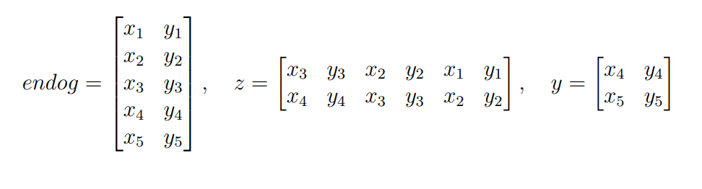
Example with two trajectories
Input = 5
Lag = 3

Slide 2
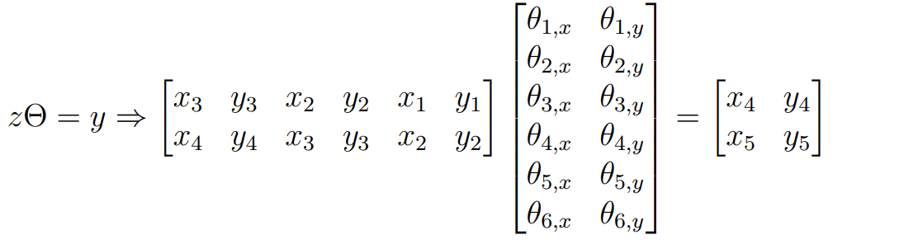
Example with two trajectories
Input = 5
Lag = 3

Slide 3
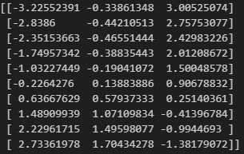
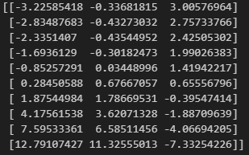
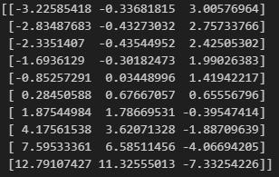
Forces on O (O_x, O_y, O_z)
Input = 12
Lags = 4
Data
Own code
Statsmodel OLS

Slide 4
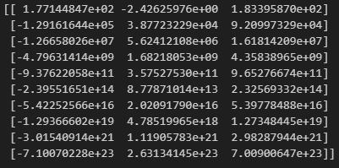
Forces on O (O_x, O_y, O_z)
Input = 12
Lags = 4
Data
Own code
Statsmodel OLS

Slide 5
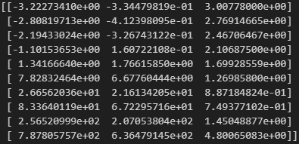
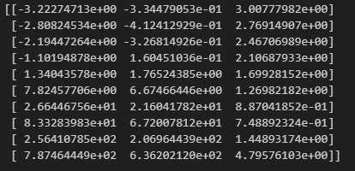
Matrix must not be underdetermined
Input-lags ≥ lags*trajectories
Forces on O (O_x, O_y, O_z)
Input = 12
Lags = 3
Data
Own code
Statsmodel OLS

Slide 6
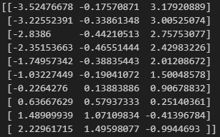
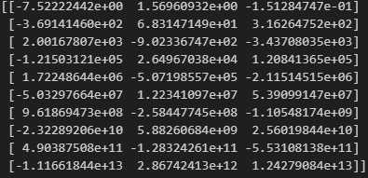
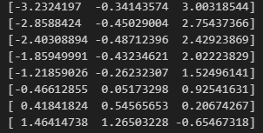
Matrix must not be underdetermined
Input-lags ≥ lags*trajectories
Forces on O (O_x, O_y, O_z)
Input = 11
Lags = 3
Data
Own code
Statsmodel OLS

Slide 7
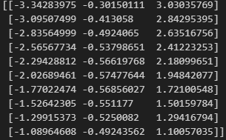
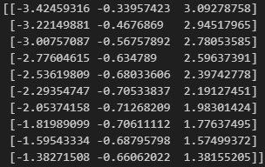
Forces on O (O_x, O_y, O_z)
Input = 12
Lags = 3
alpha = 0.1
Data
Own code
Statsmodel OLS

Slide 8
Summary
Using np.linalg.lstsq gives same result as OLS
Calculating the parameters using normal equation
Gives approximately the same result with well determined matrix
Input-lags ≥ lags*trajectories
Can give problems on VAR with many trajectories
Problems with underdetermined and ill conditioned matrices
Regularization gives a different result to OLS
Seems to do the right thing
OLS and np.linalg.lstsq uses SVD to solve linear least square
Does not have problems with underdetermined matrix

Slide 9
Summary
Future tasks
Create code using SVD
Check condition number and distribution of errors
Integrate with gpaw
Evaluate/optimize the model and run simulations

Slide 10
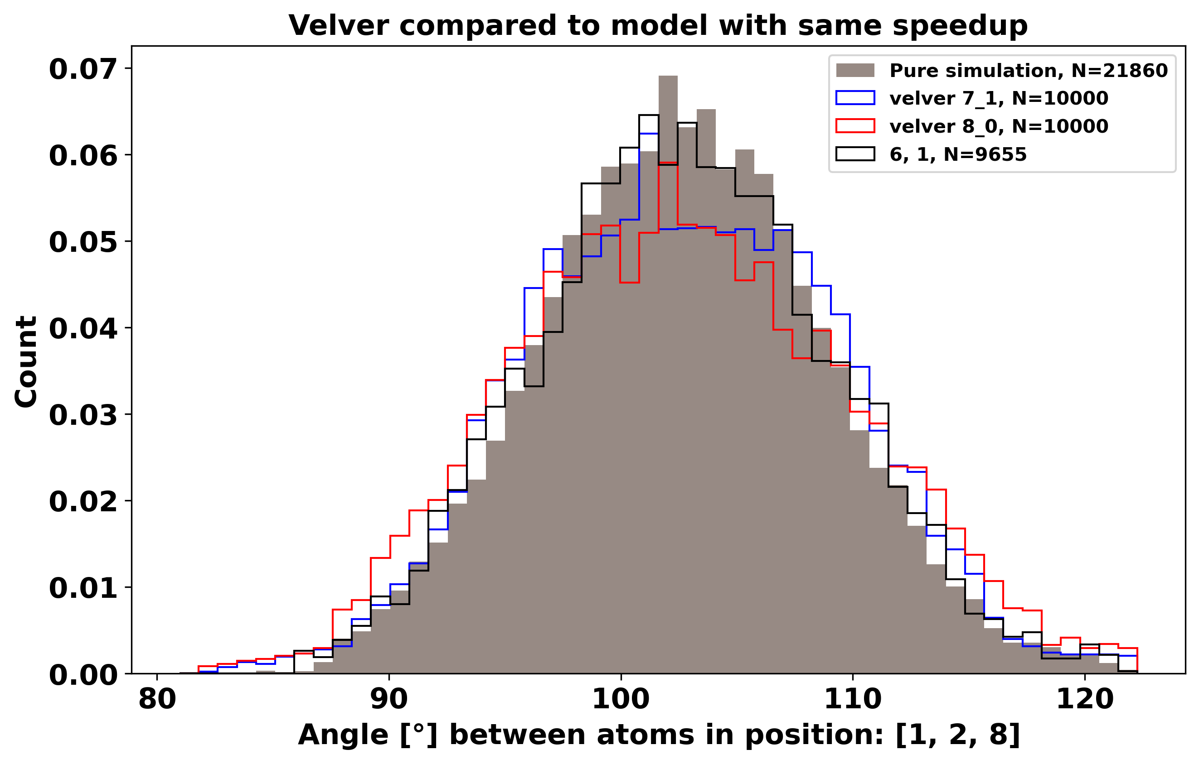

Slide 11
Using PCA for regularization by reducing number of parameters

